Slide 1
Credit Card Fraud Detection

Slide 2
Project
Tarurendra Kushwaha

Slide 3
Introduction
'Fraud' in credit card transactions is unauthorized and unwanted usage of an account by someone other than the owner of that account.
Fraud detection involves monitoring the activities of populations of users in order to estimate, perceive or avoid objectionable behavior, which consist of fraud, intrusion, and defaulting.

Slide 4
Objectives
The aim of this project is to predict whether a credit card transaction is fraudulent or not, based on the transaction amount, location and other transaction related data. It aims to track down credit card transaction data, which is done by detecting anomalies in the transaction data.
Credit card fraud detection is typically implemented using an algorithm that detects any anomalies in the transaction data and notifies the cardholder (as a precautionary measure) and the bank about any suspicious transaction.

Slide 5
Technology Used
To detect and stop credit card fraud, a credit card company analyzes data that it receives from merchants about the consumers who have made purchases with their card. The credit card company automatically compares the data from the purchase with previously stored data on the consumer to determine whether the purchase and consumer are consistent. A computer analyzes the consumer's data and compares it with the data from the purchase. The computer also attempts to detect any difference between the consumer's history of purchases and the current purchase. The computer then makes a risk analysis for the purchase and determines whether the company should allow the purchase to go through
Flask
Random Forest Classifier
HTML\CSS
Machine Learning
Kaggle

Slide 6
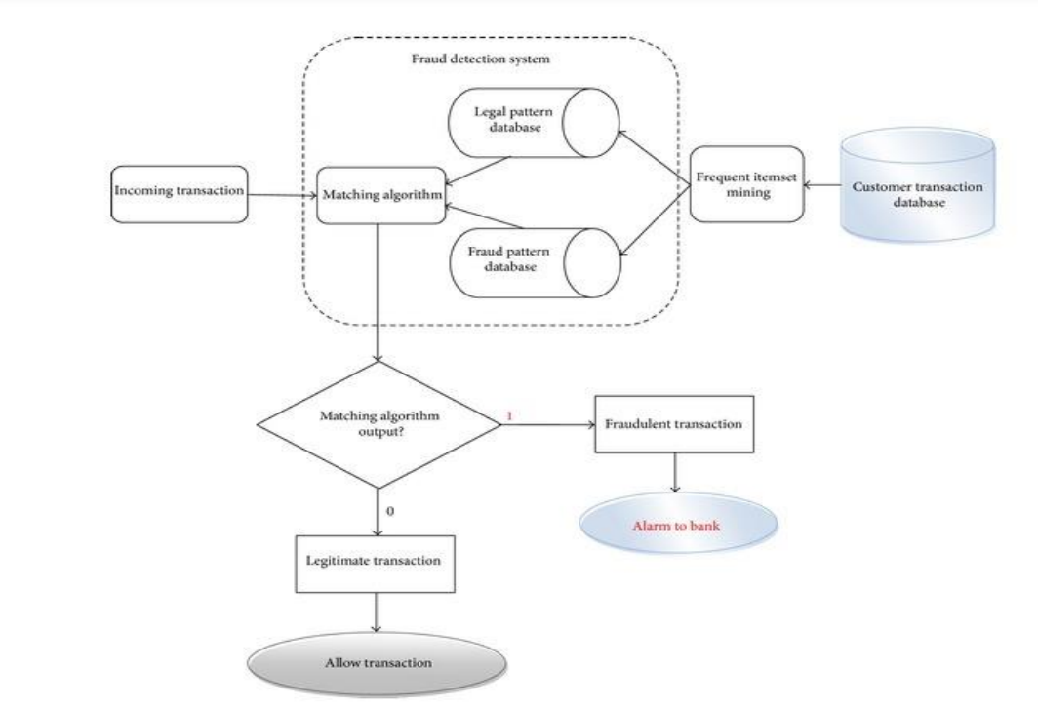
DFD Diagram

Slide 7
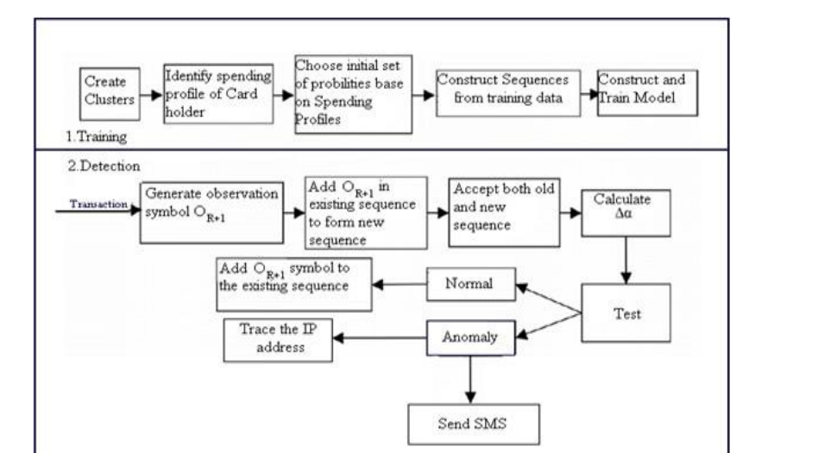
System Architecture

Slide 8
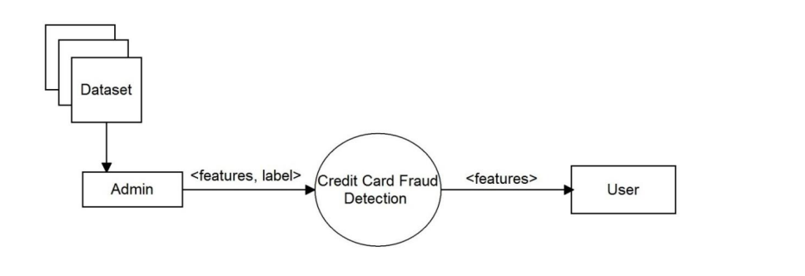
Data Flow Diagram for data extraction

Slide 9
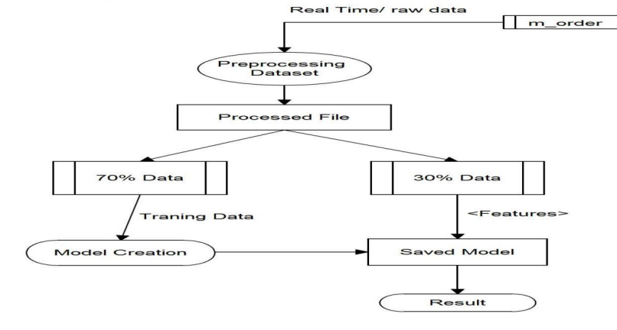
Data Flow Diagram for classification of data

Slide 10
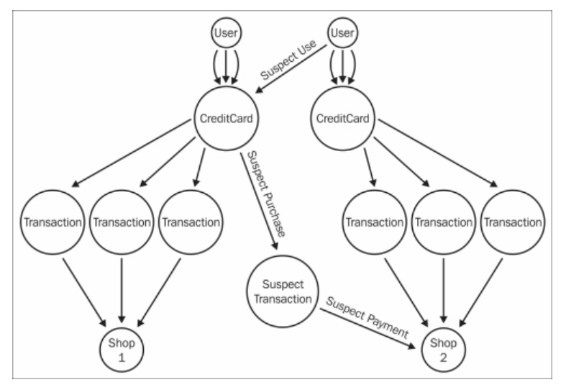
Use Case Diagram

Slide 11
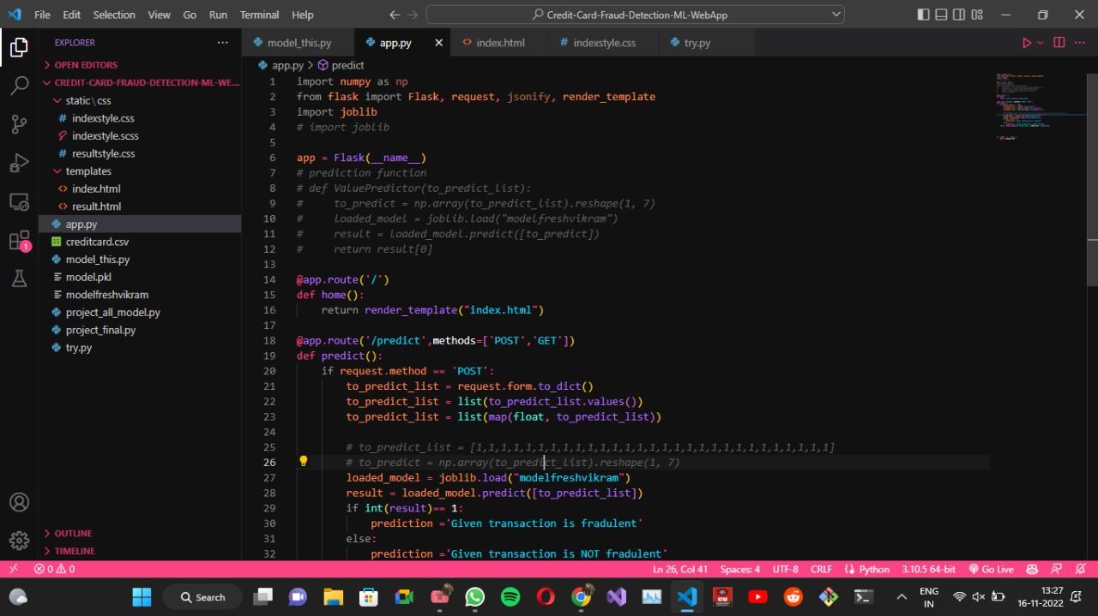
Project Screenshots

Slide 12
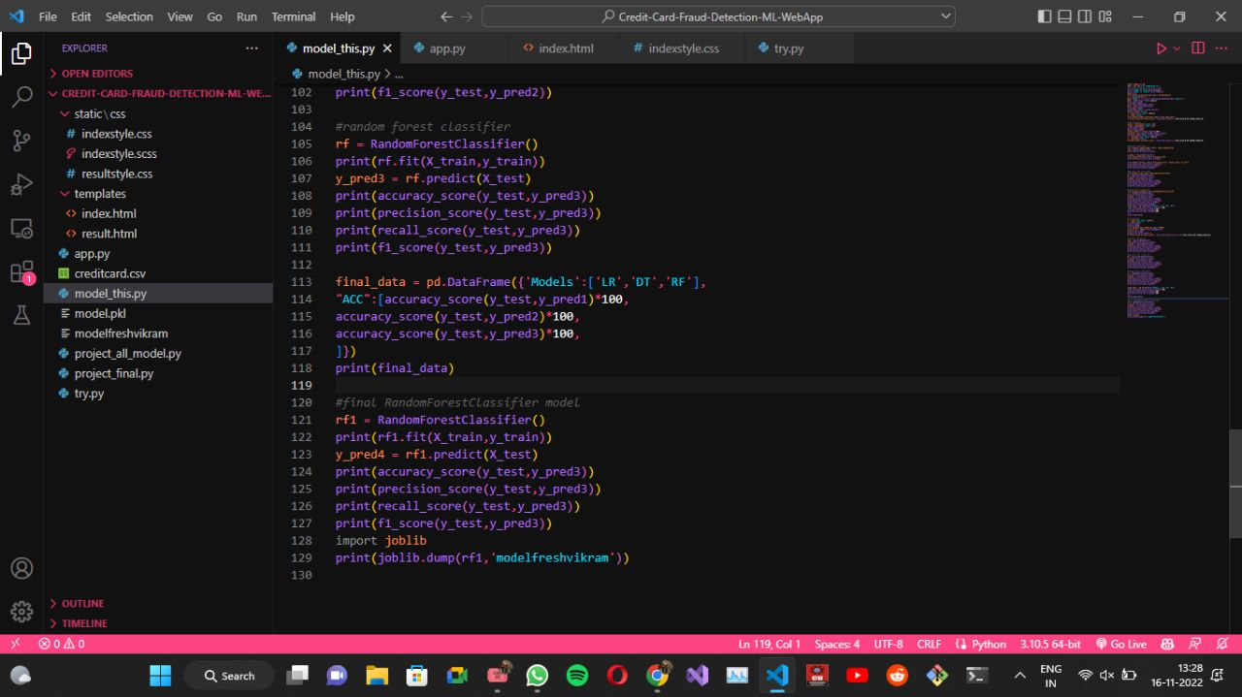

Slide 13
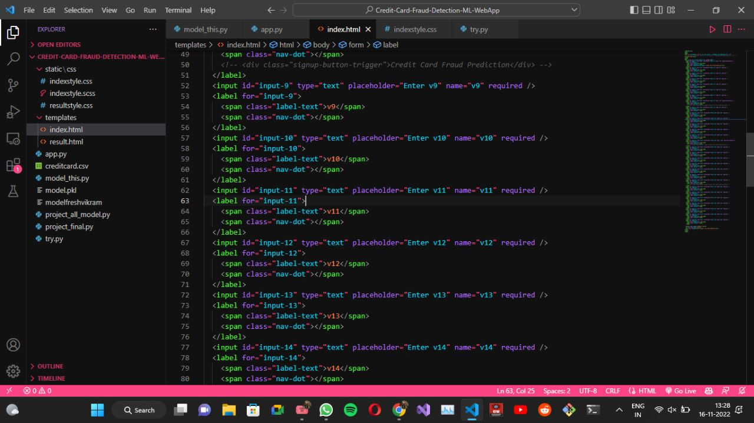

Slide 14
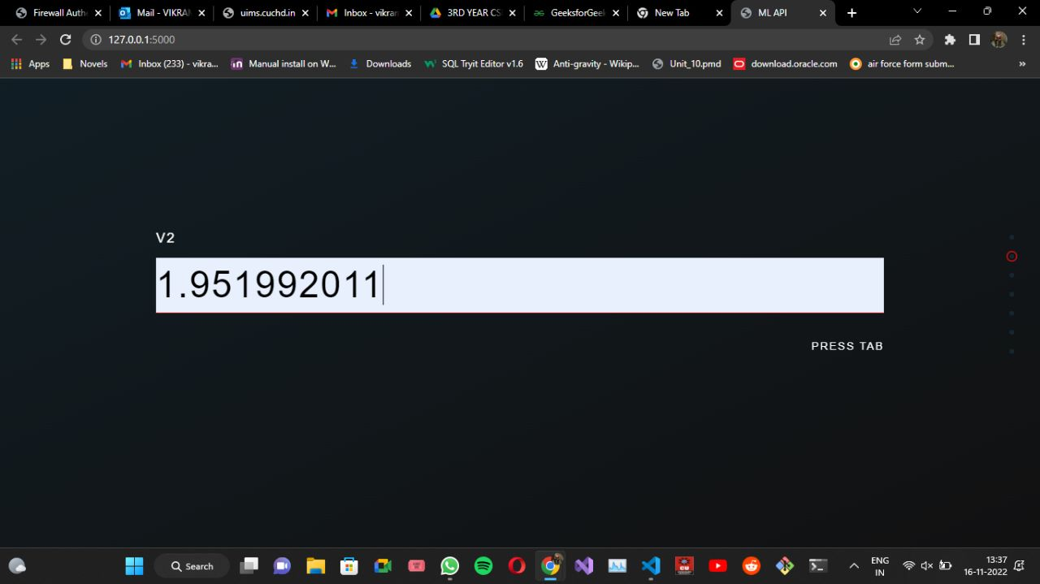
Values To be Put in Web Sites

Slide 15
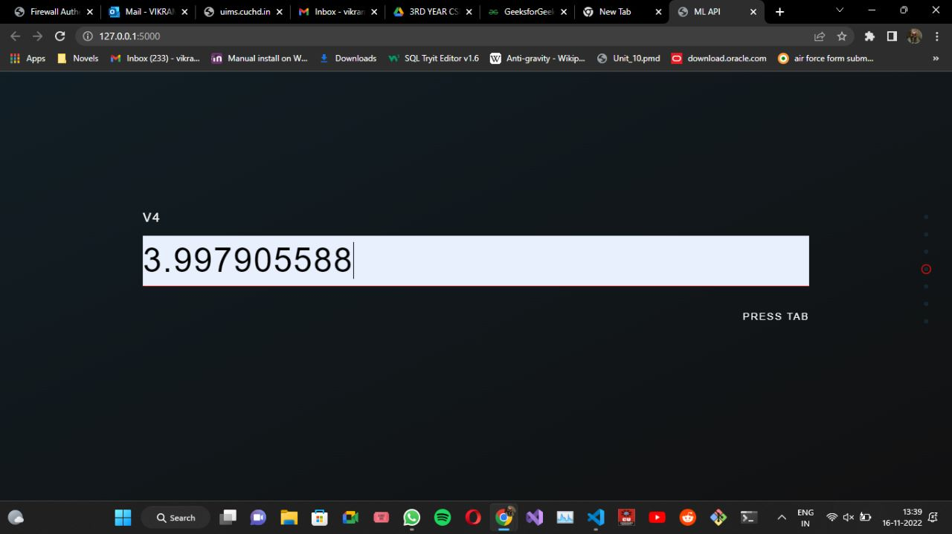

Slide 16
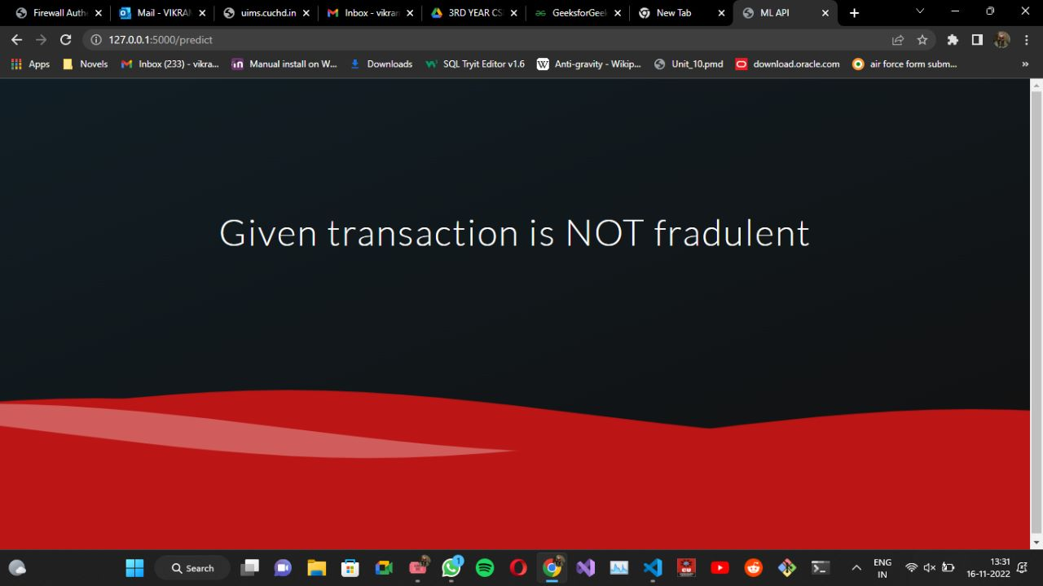
Fraud not Found

Slide 17
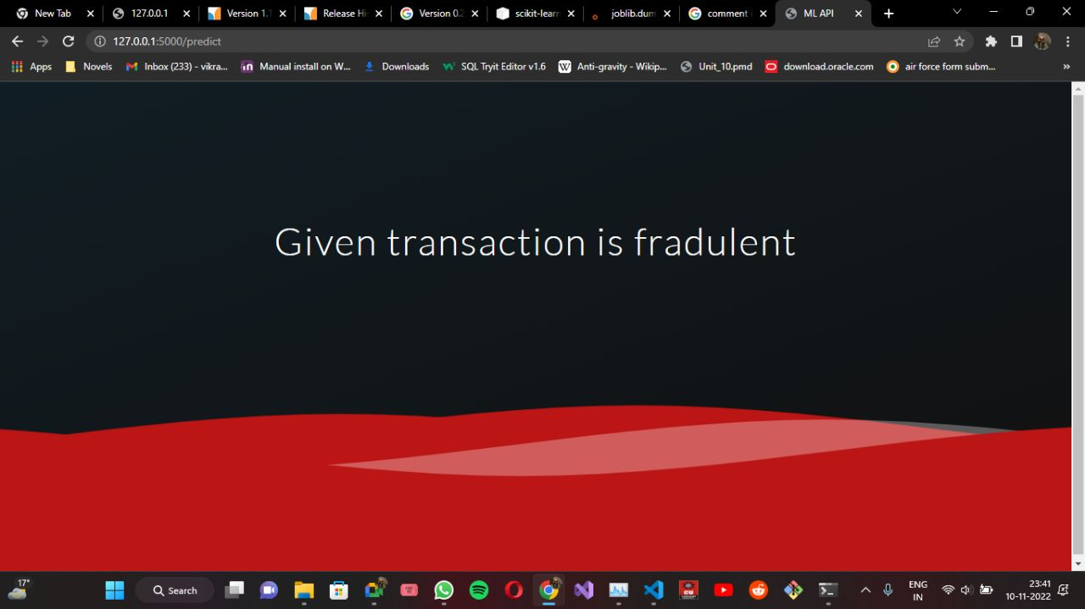
Fraud Found

Slide 18
Conclusion
Credit card fraud is most common problem resulting in loss of lot money for people and loss for some banks and credit card company.
This project want to help the peoples from their wealth loss and also for the banked company and trying to develop the model which more efficiently separate the fraud and fraud less transaction by using the time and amount feature in data set given in the Kegel.
First we build the model using some machine learning algorithms such as logistic regression, decision tree, support vector machine, this all are supervised machine learning algorithm in machine learning.

